Slide 1
Genealogical Proof Standard http://www.bcgcertification.org/resources/standard.html
Reasonably exhaustive research
Complete, accurate citations to the source or sources of each information item
Tests—through processes of analysis and correlation—of all sources, information items, and evidence
Resolution of conflicts among evidence items
Soundly reasoned, coherently written conclusion.
!/2 hour video by Ancestry.com guru, Crista Cowan, covering the reasonably exhaustive search is online at https://www.youtube.com/watch?v=TG_fJMCFmt4

Slide 2
On the Same Page
FREE Websites for Genealogists
Barbara Snow (barbsnow@comcast,net)
April, 2017

Slide 3
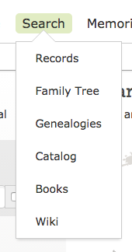
SEARCH FamilySearch.Org
Wiki – genealogical help
  Genealogical research advice
  Learn where to find record collections in our 85,012 articles
Catalog –what library owns
  Town, county, state
  Film, paper, digital
Records—digital collection of some of what library owns
  Index (no image attached)
  Indexed + image
  Image only (not indexed)

Slide 4
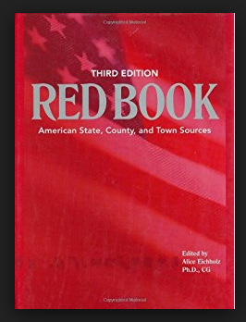
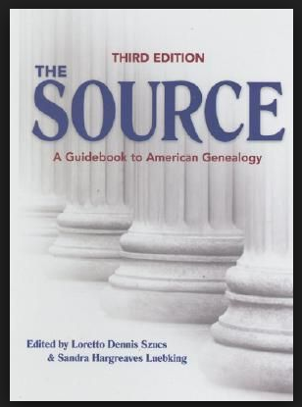
2 Classic Reference Books
Topical
The Source: A Guide to American Genealogy
Jurisdictional
Ancestry Redbook

Slide 5
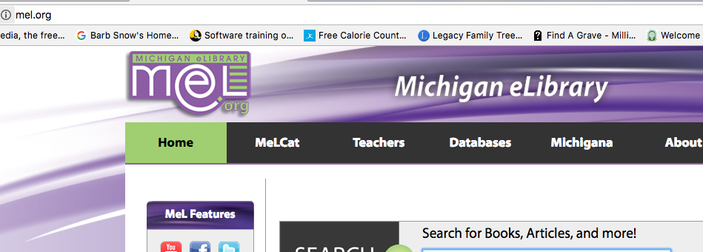
Heritage Quest http://www.mel.org > Databases > Heritage Quest

Slide 6
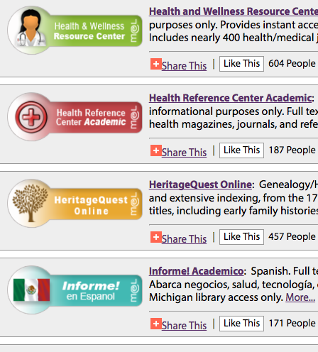
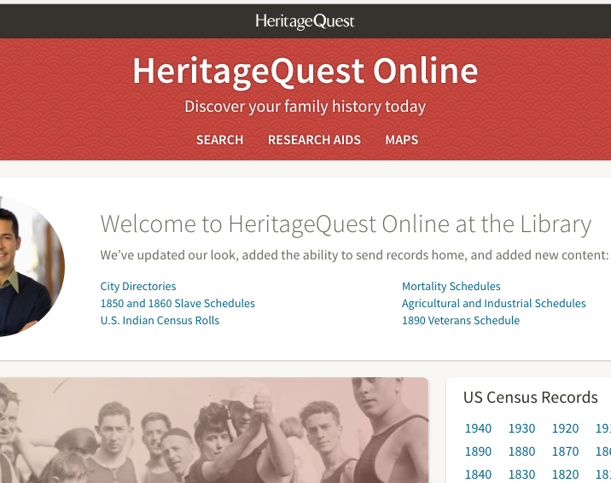
Heritage Quest Online
SEARCH-RESEARCH AIDS-MAPS

Slide 7
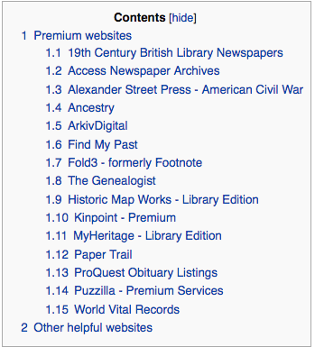
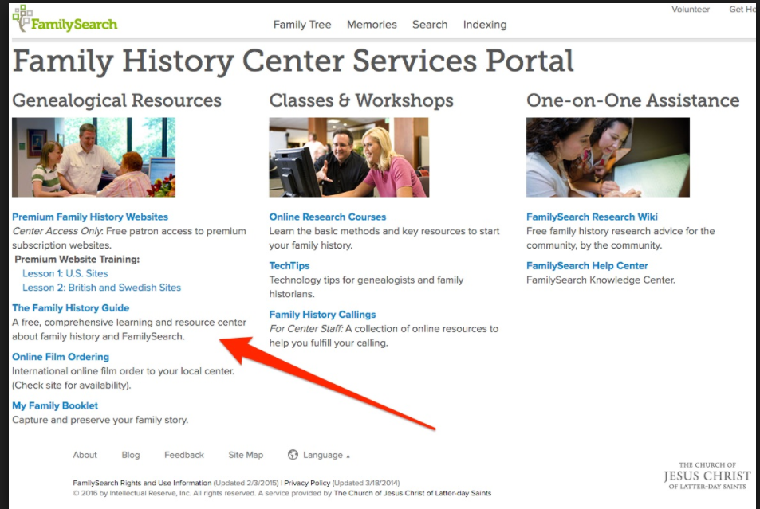
Family History Library Center Portal
(Must be in a FHC to use this.)

Slide 8
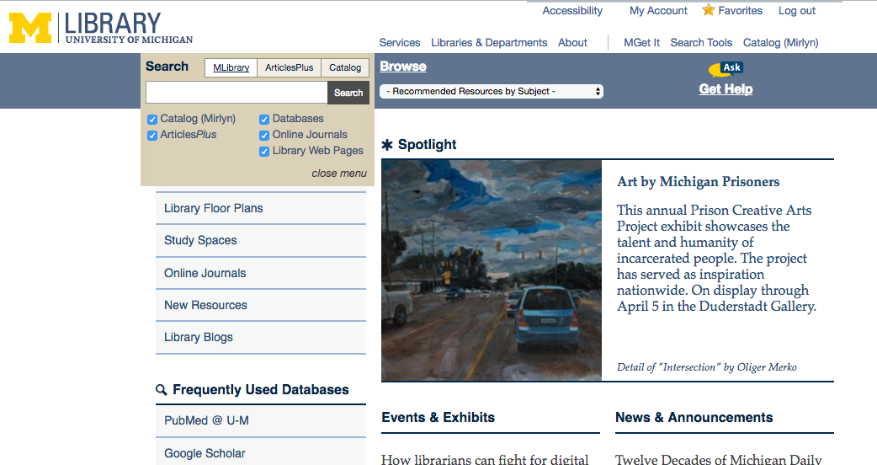
University of Michigan Library https://www.lib.umich.edu/

Slide 9
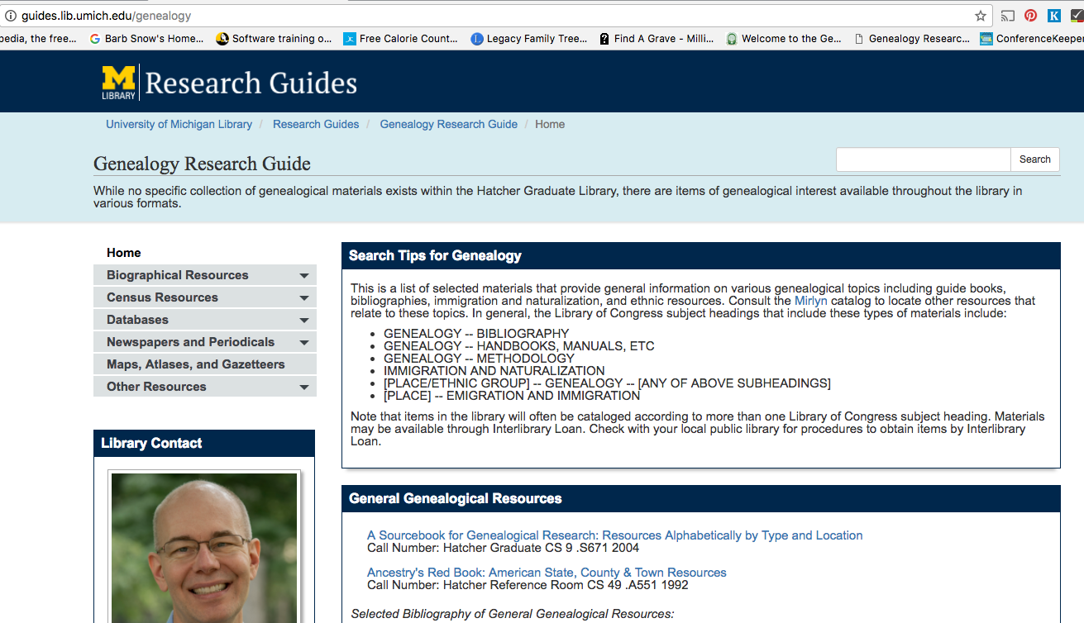
U Mich Library Genealogy Research Guide http://guides.lib.umich.edu/genealogy

Slide 10
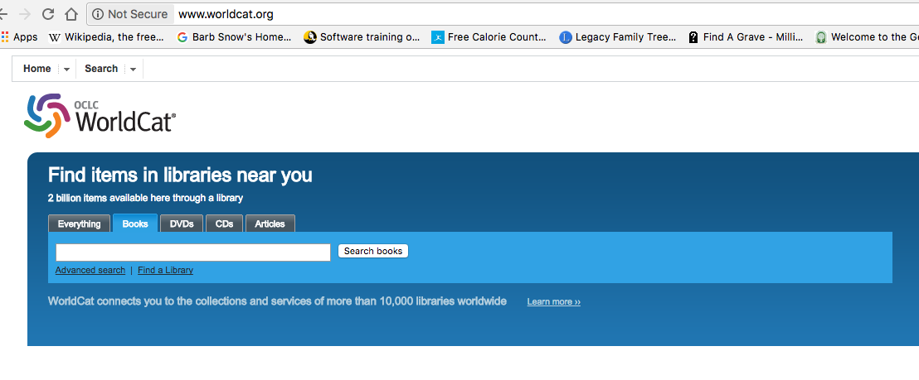
WorldCat http://www.worldcat.org

Slide 11
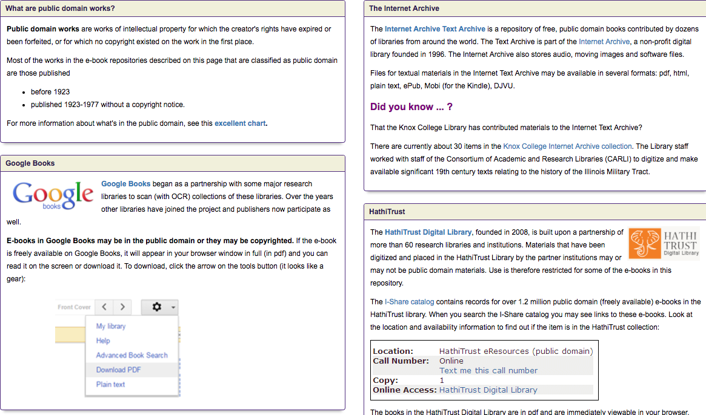
Explore Google Books, Internet Archives and Hathi Trust… http://knox.libguides.com/c.php?g=50353&p=322174 (a guide to get you started)

Slide 12
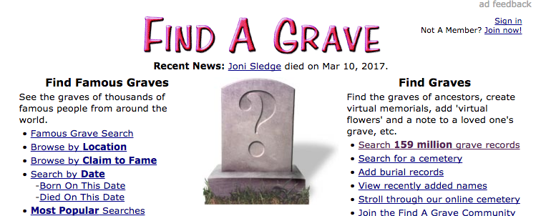
Find A Grave http://www.findagrave.com

Slide 13
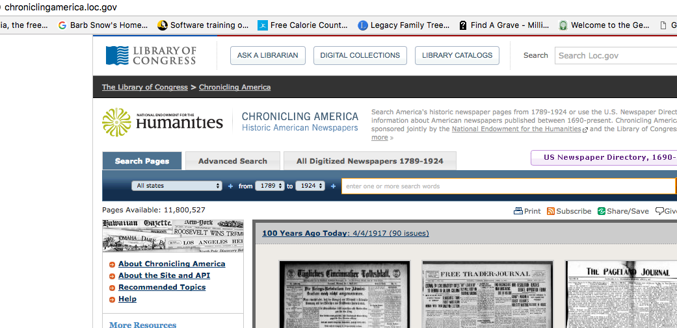
Chronicling America -- newspapers http://chroniclingamerica.loc.gov

Slide 14
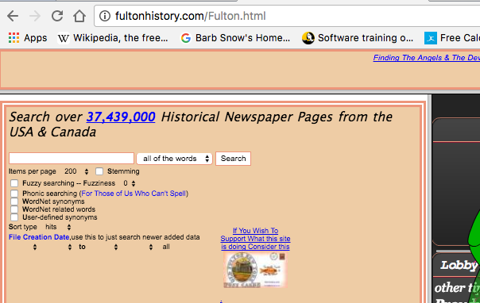
Fulton History – not just New York http://fultonhistory.com

Slide 15
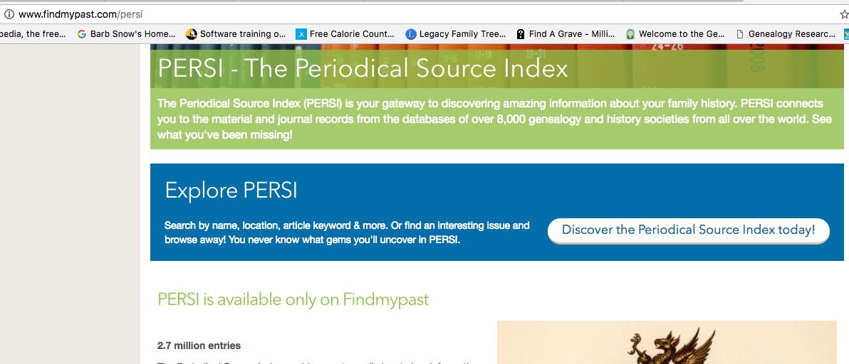
PERSI – free at FindMyPast.com http://www.findmypast.com/persi

Slide 16
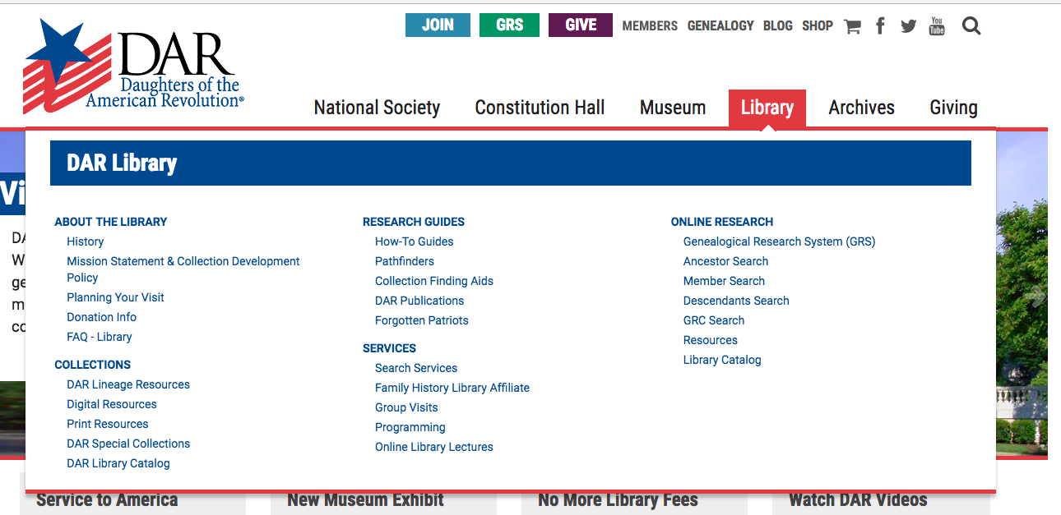
D.A. R. Library http://www.dar.org/ > Library

Slide 17
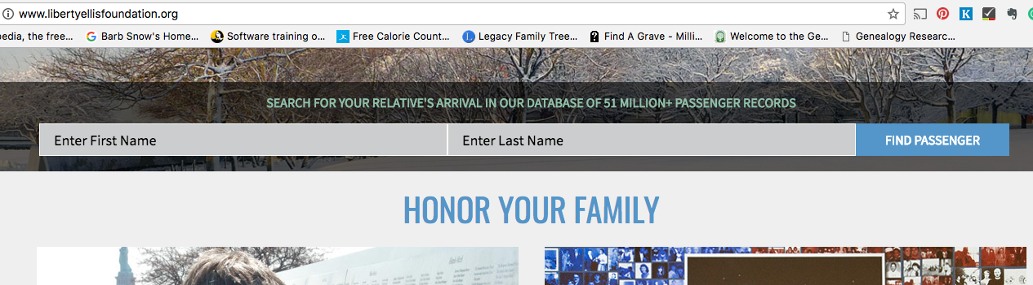
ELLIS ISLAND – for passenger lists (N.Y.) http://www.libertyellisfoundation.org/

Slide 18
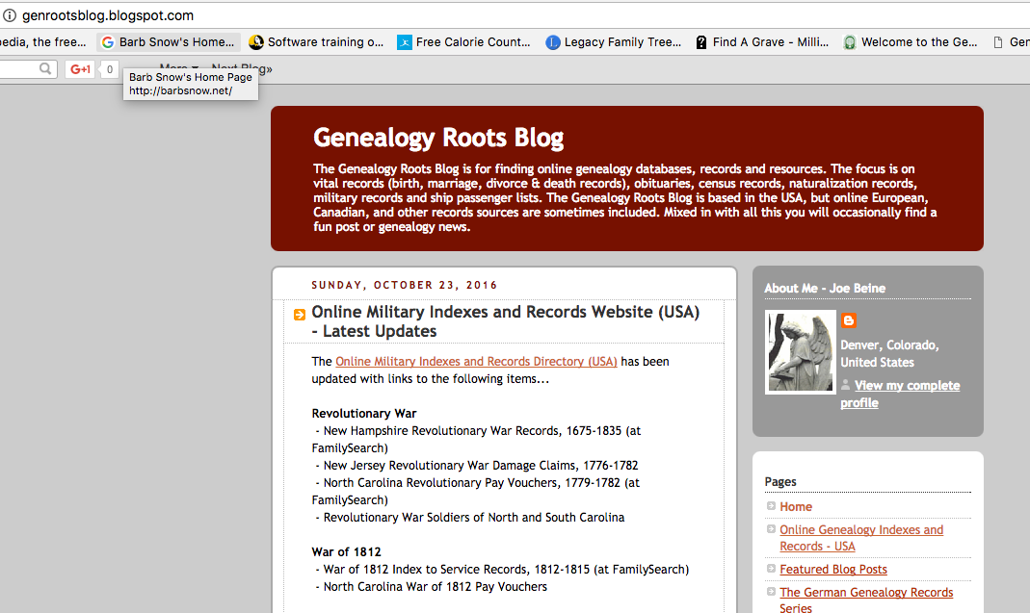
Joe Beine’s pages… find them at his blog http://genrootsblog.blogspot.com/

Slide 19
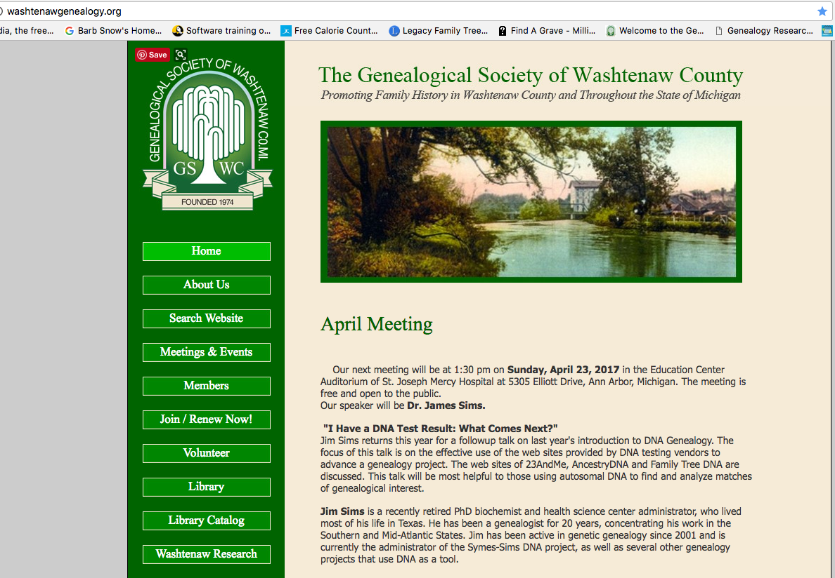
Genealogical Society of Washtenaw County http://www.washtenawgenealogy.org

Slide 20
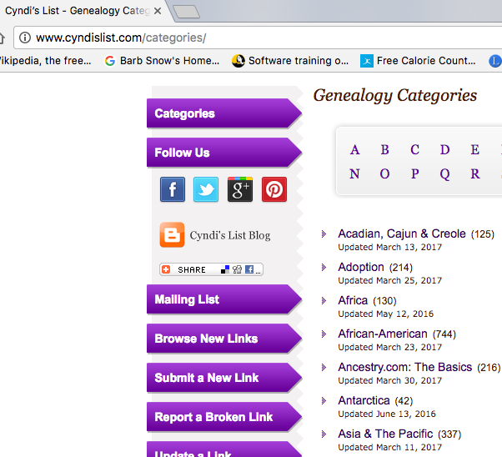
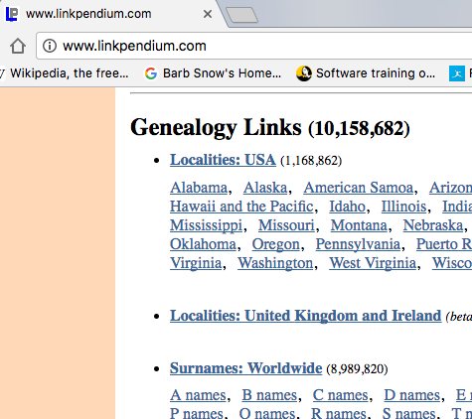
Searching the internet…
Cyndi’s List Linkpendium

